Slide 1
STEM High Altitude Balloon Launch

Slide 2
2023 launch Videos and Pictures
NWHS Highlight video https://vimeo.com/statefarmhq
NCHS Highlight Video https://youtu.be/xQFqYOEl7qo
NCHS Balloon Burst 360 slowmo https://vimeo.com/statefarmhq
NCHS time lapse video https://vimeo.com/822099456
NCHS Insta360 video https://youtu.be/GE7wcSeM3zs

Slide 3
Telemetry analysis
4/21 NWHS Notebooks
https://github.com/StateFarm-STEM/hablogger/tree/main/telemetry-analysis/flights/normalwesths-2023-04-21
4/28 NCHS Notebooks
https://github.com/StateFarm-STEM/hablogger/tree/main/telemetry-analysis/flights/normalcommunityhs-2023-04-28
https://github.com/StateFarm-STEM/hablogger/tree/main/telemetry-analysis/flights/boyscouts-2023-04-29

Slide 4
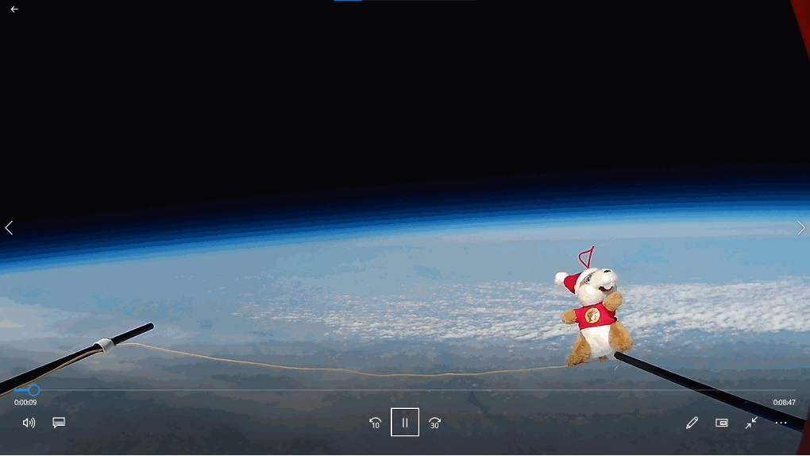

Slide 5
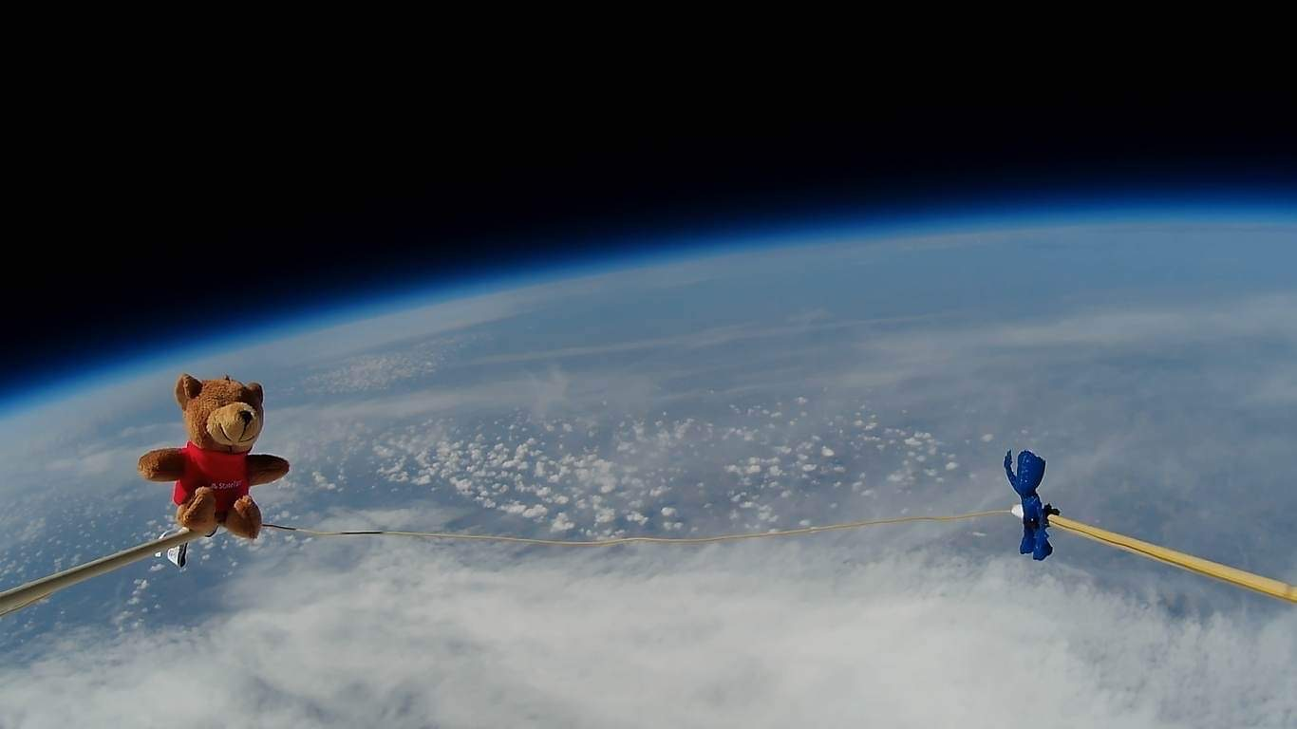


Slide 6
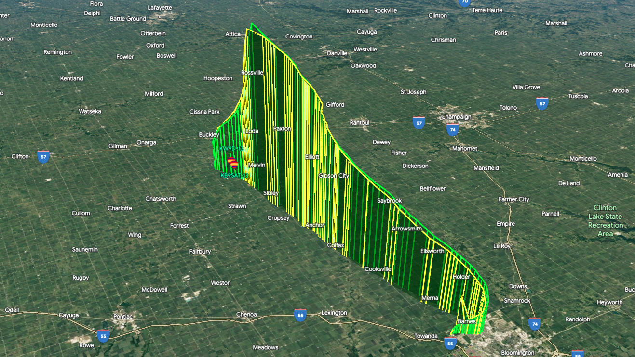

Slide 7
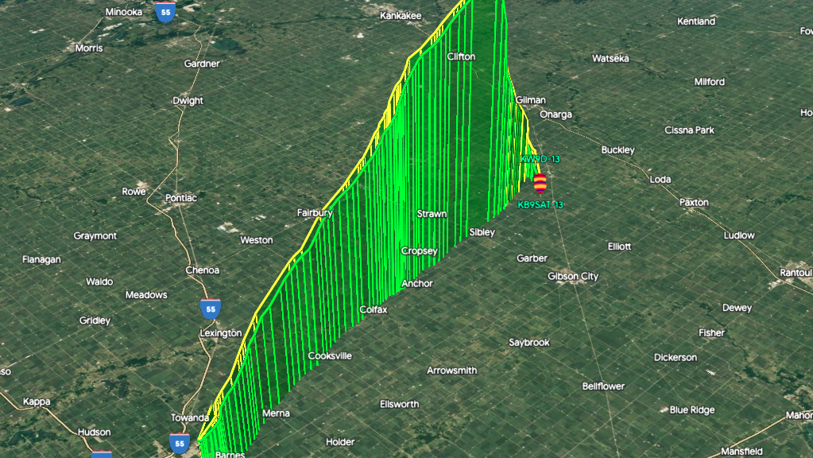

Slide 8
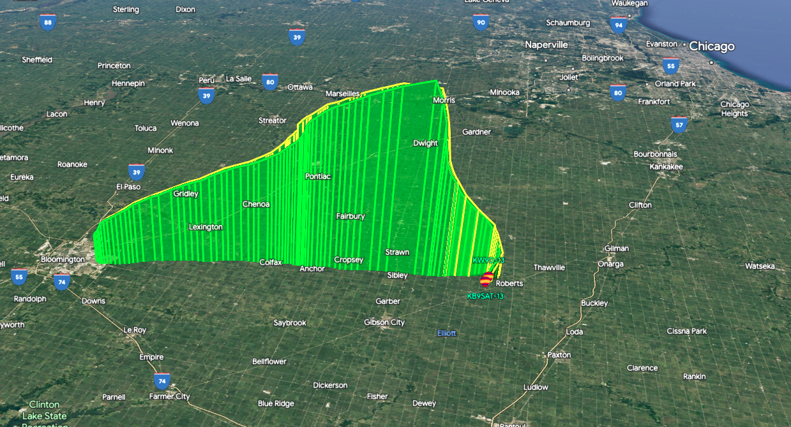

Slide 10
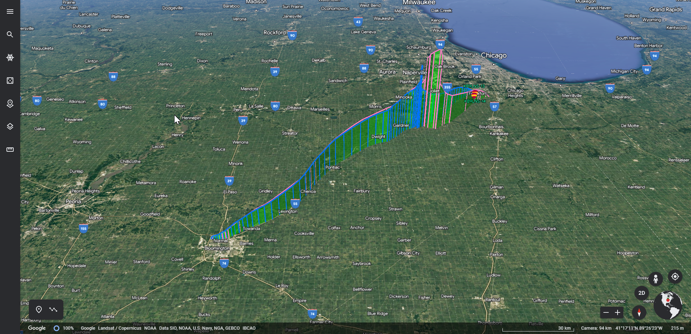

Slide 11
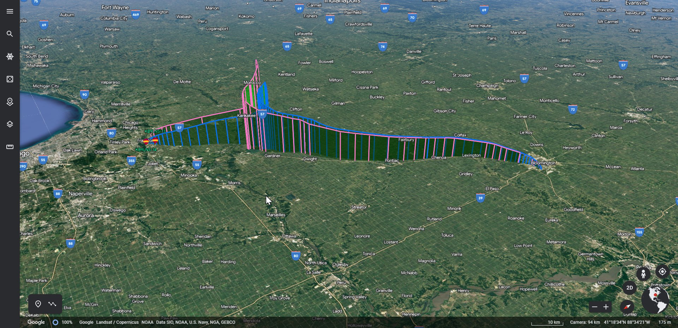

Slide 12
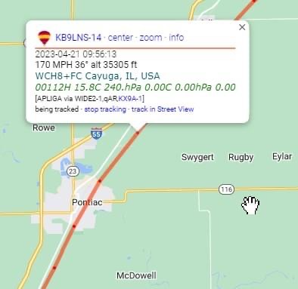

Slide 13
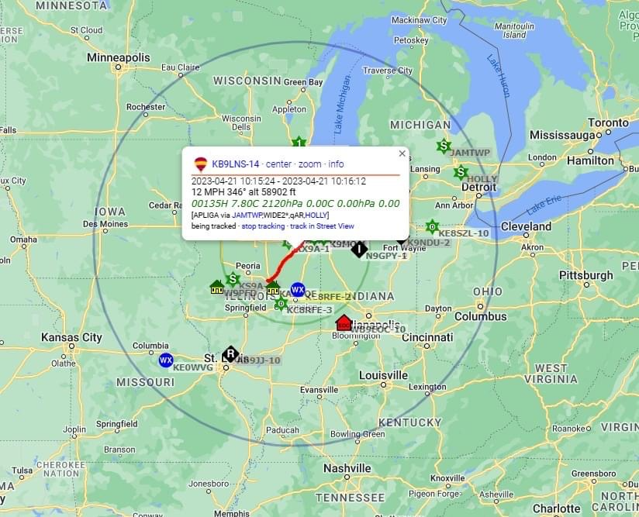

Slide 14
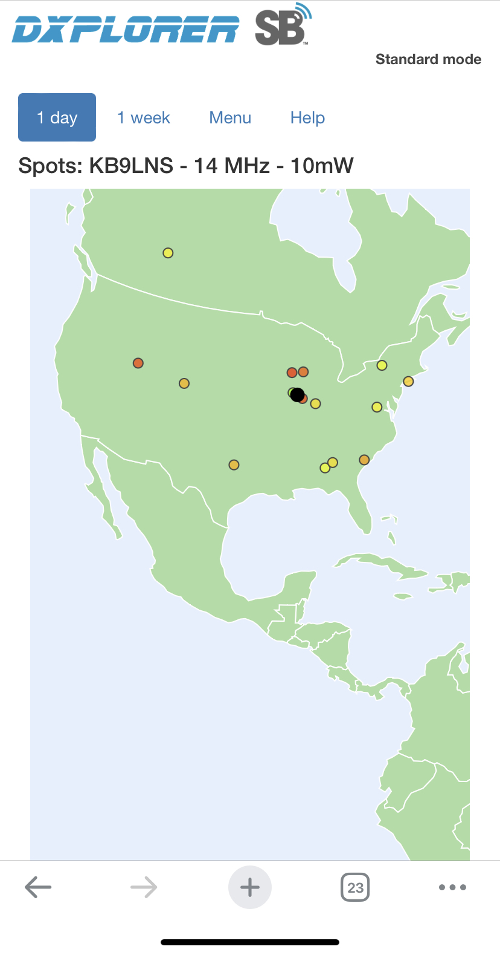
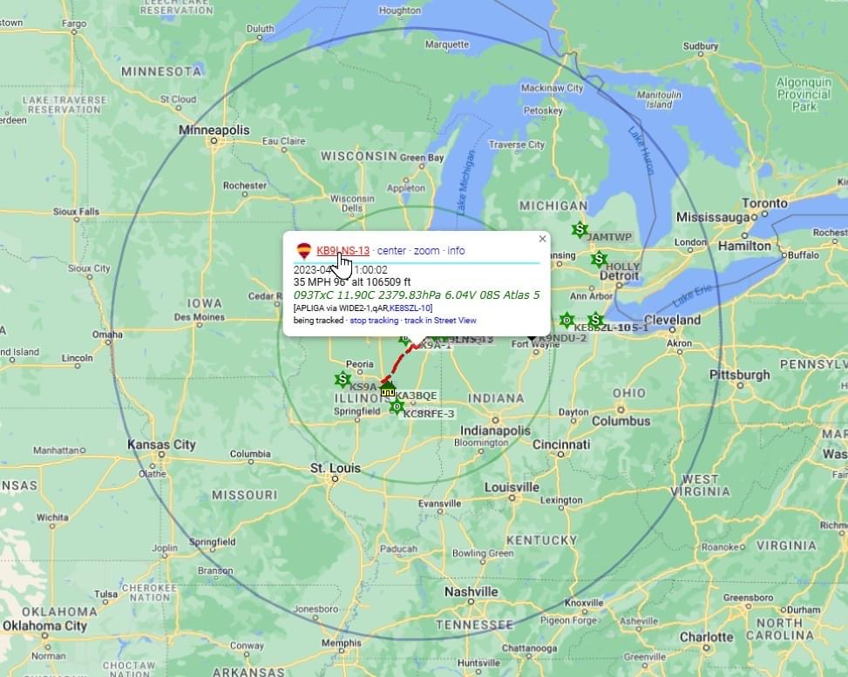

Slide 15
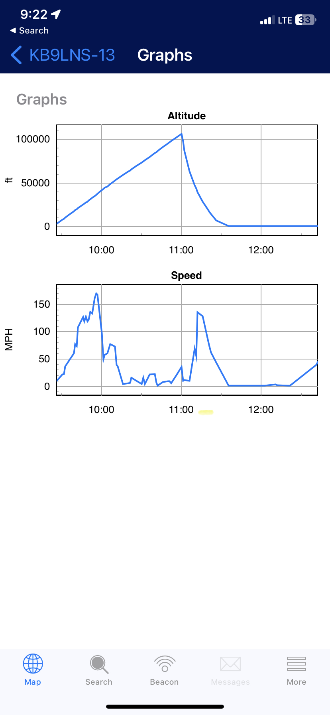
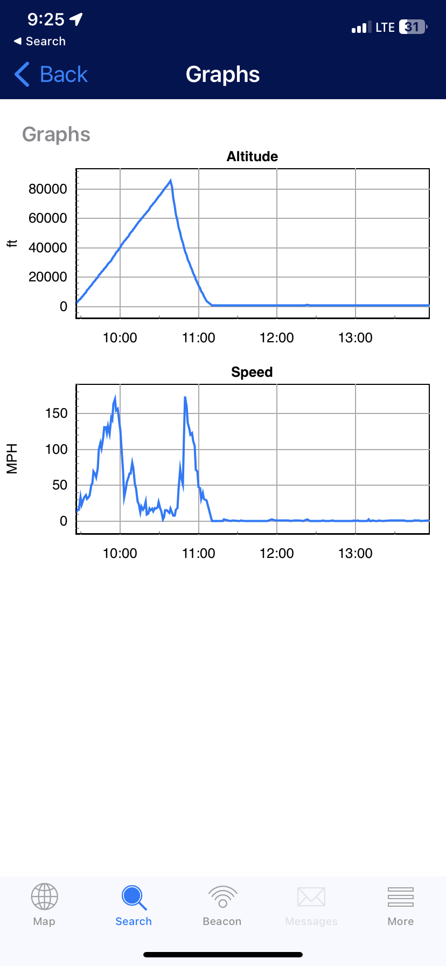

Slide 16
Lessons Learned
What did you enjoy most
What would you change
What would you have liked to see more of
What would you have liked to see less of
Did this help you apply coding?
Is coding in your future?

